Slide 1

Boundaries and Lines: the art of reconstruction
E/Ea (they/them)¹
Supervisor: Dr. Tracey Balehowsky
¹Faculty of Science
University of Calgary​
Sum-C Summer Seminar
Notes:
Hey everyone! My names E or Ea, they them. I’d like to thank Taha and the rest of the SUM-C team for putting this seminar together! Today I would like to take you on a little journey through the field of inverse problems in the context of my Summer Research.

Slide 2
Roadmap
Introduction​ to Inverse Problems
CT Imaging and the Radon Transform
​Statement of the problem
Probing microlocal boundary properties
​Summary​
Notes:
To begin I’ll give an informal introduction to what inverse problems are with a host of examples and applications. Following this introduction, I’ll provide examples of inverse problems in medical imaging, as well as the tool of primary interest in these types of problems, the Radon transform. Next I will describe the inverse problem I studied over the summer before jumping into the primary tools from microlocal analysis which let us probe microlocal structures and derivatives related to our boundary of interest.

Slide 3
What is an inverse problem?
“A problem with the goal of reconstructing information through indirect measurements”
Notes:
To begin, what exactly is an inverse problem? There isn’t a single precise definition, at least to my knowledge, but I like to think about it as a problem with the goal of reconstructing information through indirect measurements. What is the information you want to reconstruct, or the method of indirect measurement? Well both of these can vary wildly

Slide 4
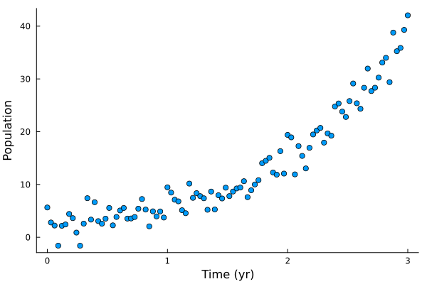
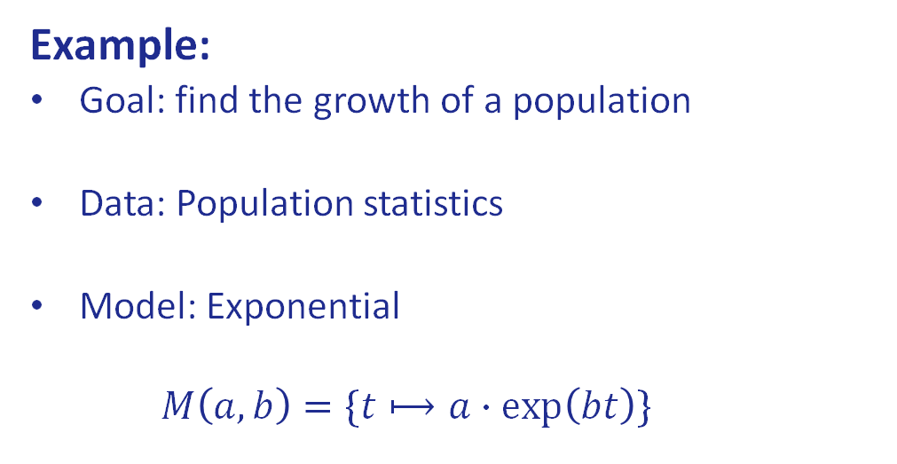
What is an inverse problem?
“A problem with the goal of reconstructing information through indirect measurements”
Example:
Goal: find the growth of a population
Data: Population statistics
Model: Exponential
$$M\left(a,b\right)=\{t⟼a∙exp\left(bt\right)\}$$
Notes:
Let’s take a simple example. Suppose you wanted to find an expression which describes the growth of some population and you have data on the population statistics over a given time interval. Suppose you also have some prior knowledge that the growth will follow some form of exponential distribution. Then your inverse problem might be finding the parameters which best describe the population growth given an exponential model.

Slide 5
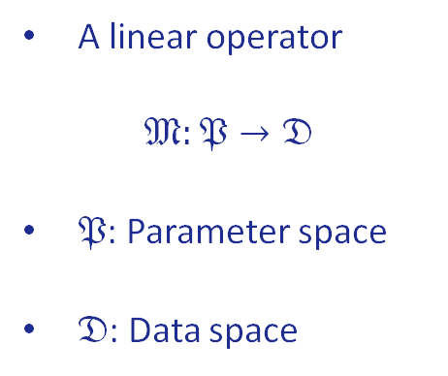


Elements of an inverse problem
Measurement operator
Noise model
Prior Model
A linear operator
$$𝔐:𝔓→𝔇$$
$𝔓$: Parameter space
$𝔇$: Data space
A noise map
$$n:𝔓×𝔇→𝔇$$
Accounting for
Detector noise
Modelling error
Purpose: To reduce noise
Restricts the parameter space $𝔓$ based on prior information.
Notes:
More formally an inverse problem can be considered to consist of three primary ingredients: A measurement operator, a noise model, and in some cases a prior model. The measurement operator is generally considered to be linear and taken between either Hilbert or Banach spaces. In general these spaces are infinite dimensional function spaces, but to simplify the treatment you can think of finite dimensional vector spaces over the real or complex numbers. The parameter space consists of the unknown information we want to derive from the data space. Thus, in a way this measurement operator is going in the opposite direction to what we want. In the lab we measure some results in the data space, which hopefully land in the image of our measurement operator, and then we aim to obtain a unique element of the parameter space which maps to it.
However, noise is a serious obstacle in measurement data, so having a noise model to account for detector noise and measurement error is very important. In general this is a random or stochastic model, since if it were deterministic we could simply adjust our measurement operator to account for it. Finally, the prior model seeks to reduce the noise in the way of restricting our parameter space based on prior information in hopes of removing redundant parameters. For the sake of this talk we’ll simplify our study to just considering the measurement operator.

Slide 6
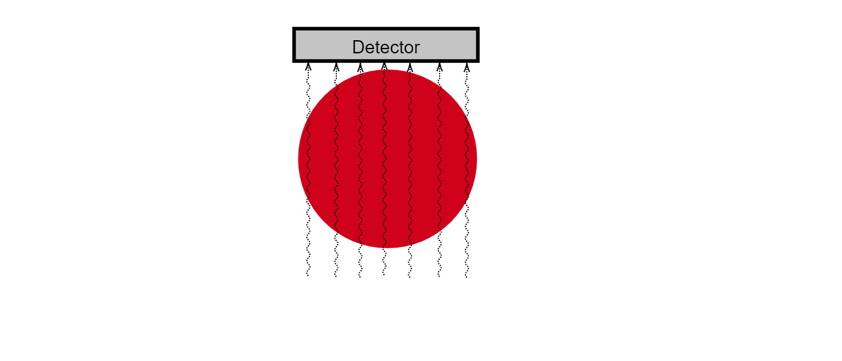
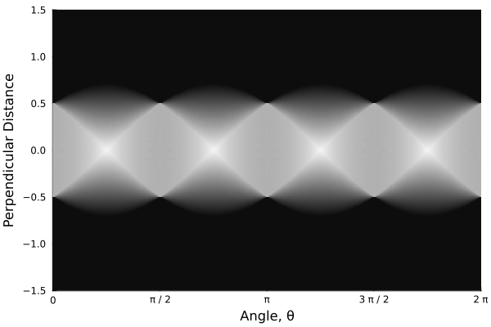
Imaging problem:
Fig. Sinogram of an unknown shape from x-ray data.
Fig. X-rays passing through an object and being picked up by a detector on the other side.
Notes:
Lets consider a practical example. Suppose we have some mystery object inside some box we can’t look inside. Suppose we however do have a way of probing the contents of the box by sending x-rays through and detecting their energy and number on the other end. How can we use this measurement data to reconstruct what’s inside the box? Pictured to the left is an example of such data, displayed in what’s called a sinogram. Do you have a guess what shape could be hidden inside the red box?

Slide 7
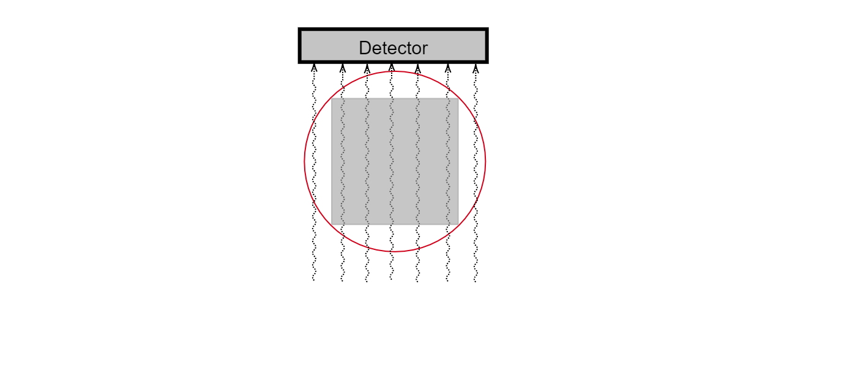
Imaging problem:
Fig. Sinogram of a square shape from x-ray data.
Fig. X-rays passing through a uniform square and being picked up by a detector on the other side.
Notes:
Right, in this case it isn’t too hard to see that it’s a square of uniform density. This is a simple example of a very common appearance of inverse problems in medical and seismic imaging. But, since I’ve told you what constitutes an inverse problem, you may be asking what the measurement operator is in this setup
(need to unfill red circle to reveal square)

Slide 8
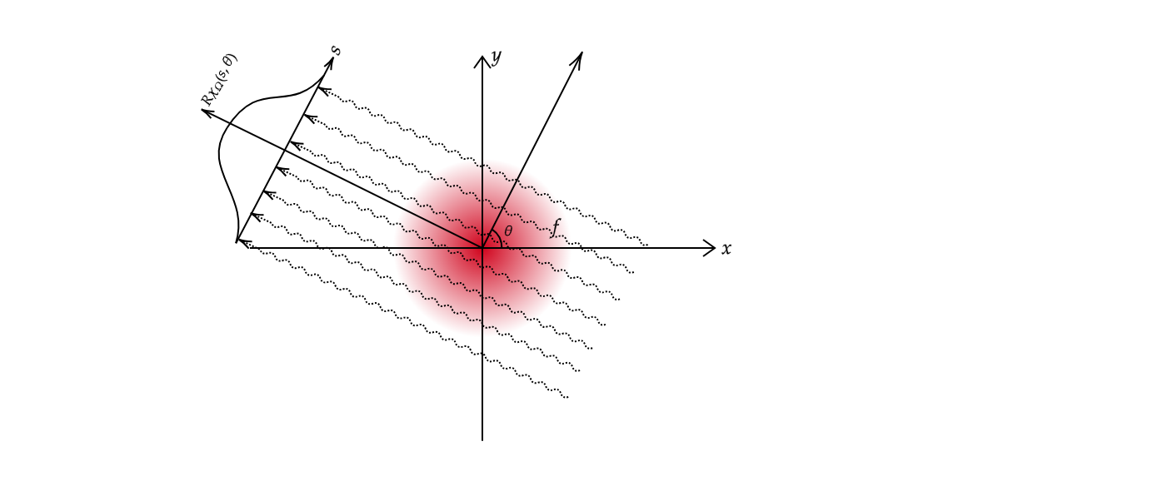
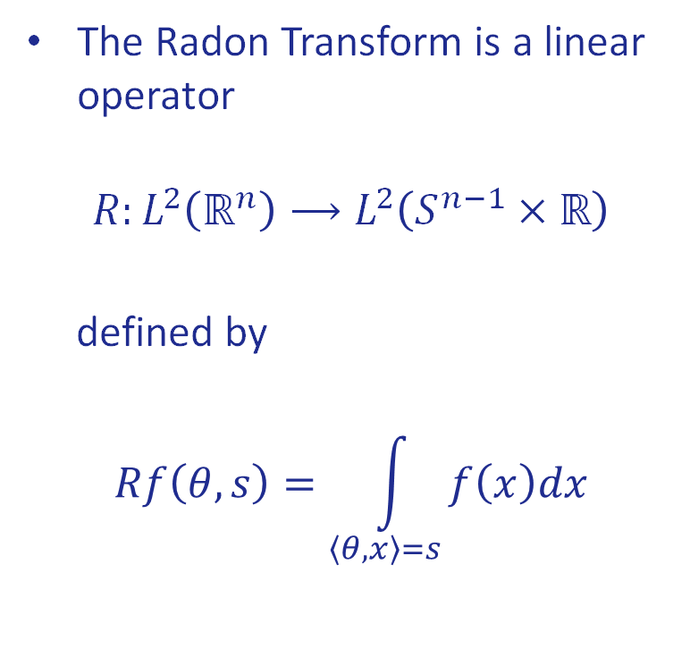
Radon Transform
The Radon Transform is a linear operator
$$R:L^{2}\left(ℝ^{n}\right)⟶L^{2}\left(S^{n−1}×ℝ\right)$$
defined by
$$Rf\left(θ,s\right)=\int_{\left\langle θ,x\right\rangle =s}^{ }{f\left(x\right)dx}$$
Fig. Model for Radon transform of a two-dimensional function f
Notes:
This is the Radon transform. The Radon Transform takes in a function, which for simplicity we will consider to be square integrable, and outputs a function on hyperplanes in Euclidean space which returns the integral of f along the given hyperplane as its value. In the case of interest for us n is 2 and the hyperplanes are simply lines in the plane. Thus the content of these imaging inverse problems involves finding an inverse of the radon transform together with suitable stability results. For the full Radon transform this is solved completely using a technique known as filtered back-projection, and is used regularly in applications such as computerized tomography in medical imaging as well as many other fields.

Slide 9
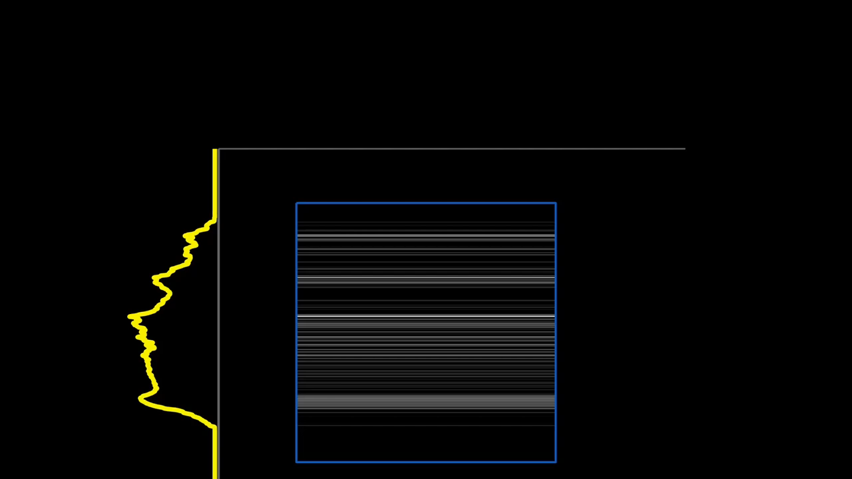
Imaging problem:
Boundaries and Lines
Vid. Samuli Siltanen Filtered Back Projection image reconstruction: https://www.youtube.com/@ssiltane/videos

Slide 10
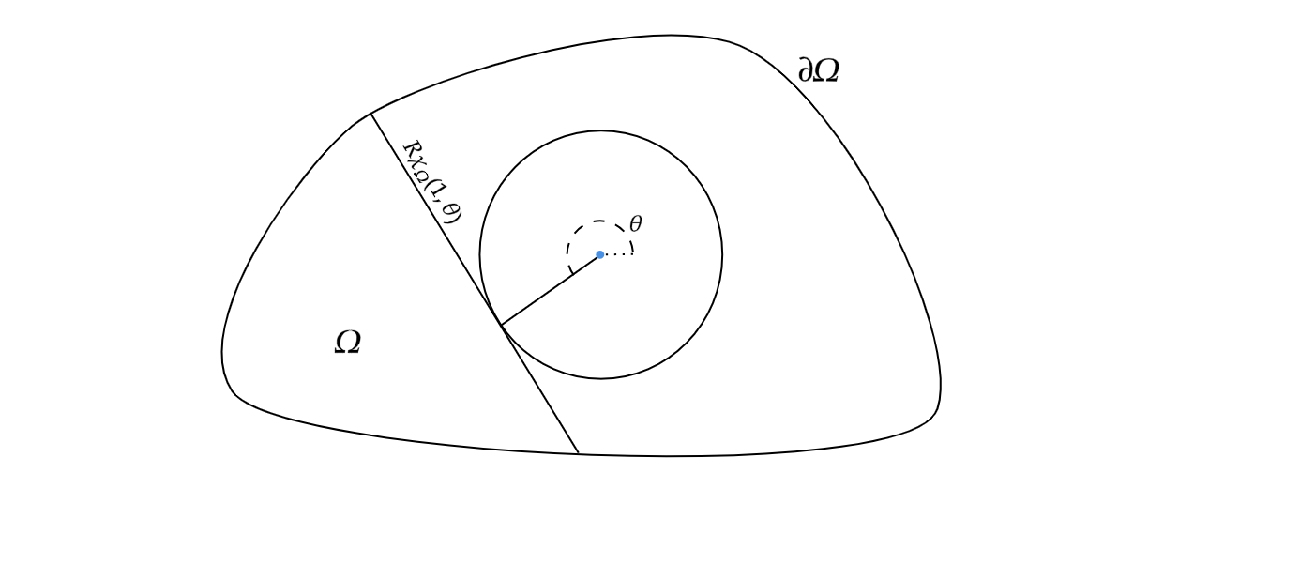

Restricted Data Transform
Data:
$Ω:$ A bounded convex domain
$Rχ_{Ω}(θ,1)$: Tangent distance between boundary points
Goal:
Arclength of $∂Ω$
A parameterization $γ:S^{1}⟶∂Ω$ in terms of the angle of tangency
Fig. Model of a convex domain with interior circle and tangent data
Notes:
This brings us naturally to the statement of the problem I investigated over the summer, which is a restricted data version of the imaging problems seen earlier. Explicitly we consider a uniform bounded domain in the plane containing the unit circle in its interior. Our data is taken to be the collection of line integrals which glance, or are tangent to, this interior circle. This is an incredibly restricted problem, making even uniqueness and stability results difficult to investigate. In particular, it is known that this data is insufficient to reconstruct a general L2 function, and in fact even a general characteristic function for a measurable set. However, the hope is that the restriction to convex domains, or at least domains for which the tangent intersects the boundary transversely and only in two locations, is sufficient to guarantee uniqueness and possibly even the ability to reconstruct the original image.
The fact that the domain of interest for this inverse problem is no longer a linear space, besides a Banach or Hilbert space, greatly reduces the tools which may be used to approach this problem.

Slide 11
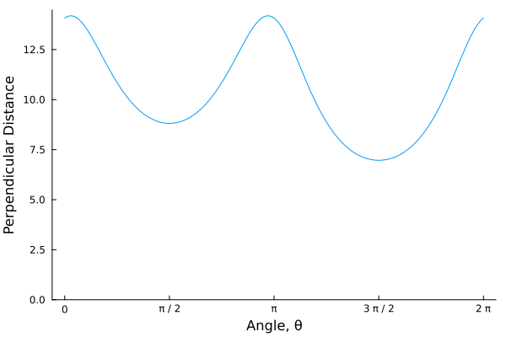
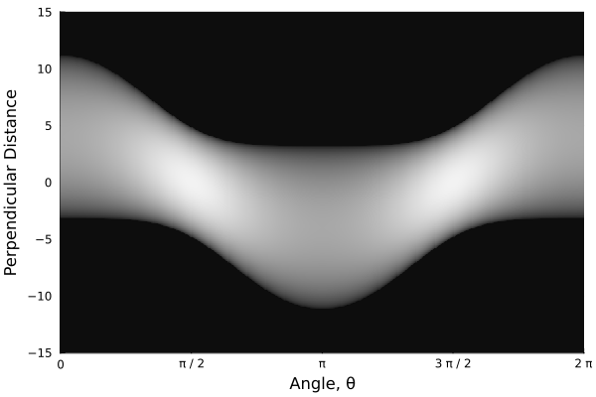
Restricted Data Transform
Fig. Sinogram of an unknown shape relative to an origin in its interior
Fig. Sinogram slice at perpendicular distance 1.
Notes:
To illustrate the limited nature of this data consider the sinogram pictured on the left which corresponds to the x-ray data for a uniform shape. If we had all of the x-ray data this is what we would see. However, our data consists only of the slice seen on the right. Any guesses as to what shape it might correspond to?

Slide 12
Restricted Data Transform
Fig. Sinogram of an ellipse relative to an origin in its interior
Gif. Ellipse reconstruction from to an interior circle
Notes:
Well it turns out that what this sinogram represents is an ellipse, albeit with the origin not located at its center of mass. Although looking just at the plot the data seems quite limiting, looking at this illustration you can see that the tangent lines sweep out all points on the boundary of the ellipse, twice in fact, which should, heuristically, capture the necessary tangency and curvature data associated with the boundary of our domain.

Slide 13
Microlocal Methods
Probing Singularities
Notes:
For the remainder of this talk I will give a brief survey of one of the subjects relevant to this study, which is the field of microlocal analysis.

Slide 14
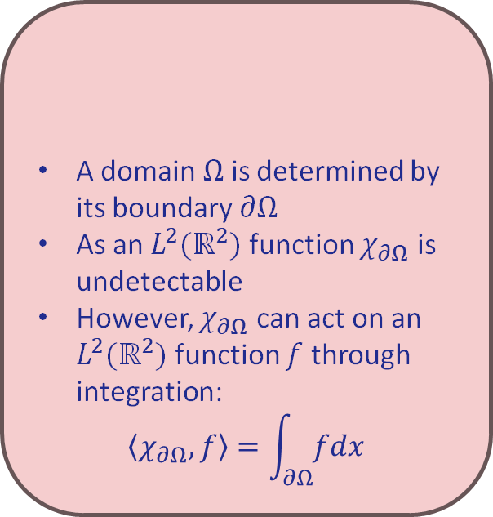
Distributions
Boundaries and Lines
A domain $Ω$ is determined by its boundary $∂Ω$
As an $L^{2}(ℝ^{2})$ function $χ_{∂Ω}$ is undetectable
However, $χ_{∂Ω}$ can act on an $L^{2}(ℝ^{2})$ function $f$ through integration:
$$\left\langle χ_{∂Ω},f\right\rangle =\int_{∂Ω}^{ }{fdx}$$
Motivation:
Notes:
To begin I’d like to introduce the notion of distributions, which play a fundamental role in this study. To motivate their let’s consider the problem at hand with our unknown domain. Due to the assumptions we have taken, the domain is completely specified by its boundary, and in a strict sense this boundary is truly what we want to determine and study. However, the characteristic function for the boundary is undetectable as an L2 function since it contains no area, making it equivalent to the zero function. For those not familiar, function in L2 space are identified up to sets of measure zero, which you can safely interpret as them not filling up a 2-dimensional region. However, the function can still be identified through its action on other functions through integration. This philosophy that functions which are otherwise undetectable may be characterized by their action on other functions brings us to the definition of a distribution.

Slide 15

Distributions
Boundaries and Lines
A domain $Ω$ is determined by its boundary $∂Ω$
As an $L^{2}(ℝ^{2})$ function $χ_{∂Ω}$ is undetectable
However, $χ_{∂Ω}$ can act on an $L^{2}(ℝ^{2})$ function $f$ through integration:
$$\left\langle χ_{∂Ω},f\right\rangle =\int_{∂Ω}^{ }{fdx}$$
Motivation:
A distribution $χ$ on $ℝ^{n}$ is a continuous linear map from $C_{c}^{∞}(ℝ^{n})$ to $ℝ$.
The space of distributions is denoted by $𝒟′(ℝ^{n})$
$L^{2}(ℝ^{n})$ embeds into $𝒟′(ℝ^{n})$ as $f↦T_{f}$ with
$$T_{f}\left(φ\right)=\int{fφdx},∀φ∈C_{c}^{∞}(ℝ^{n})$$
Definition:
Notes:
A distribution is a continuous linear map assigning real values to smooth and compactly supported functions, which we call test functions. All of our L2 functions can be identified through their action associated with integration, so they are not lost, but taking this perspective allows us to recover those undetectable functions as well as many other types of generalized functions.

Slide 16
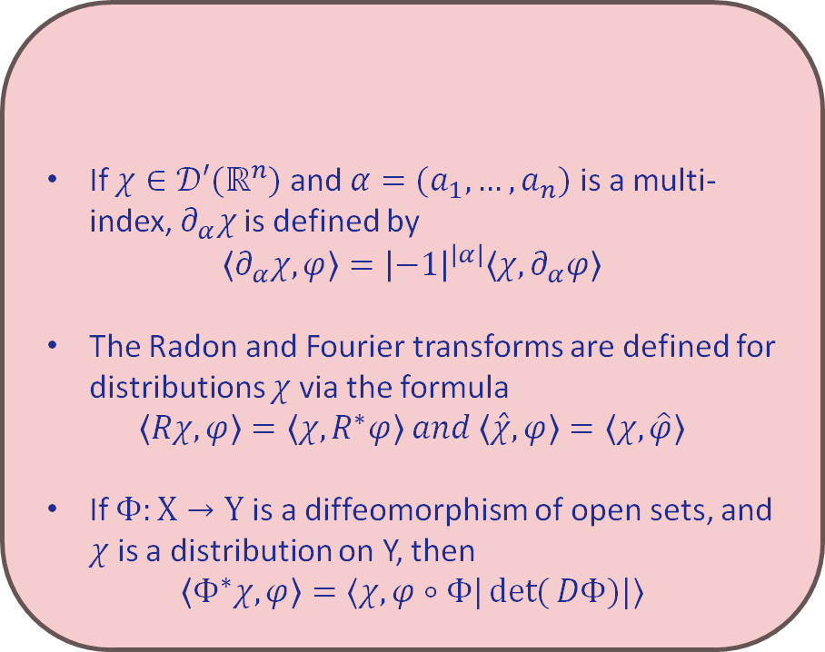

Distributions
Boundaries and Lines
If $χ∈𝒟′(ℝ^{n})$ and $α=(a_{1},…,a_{n})$ is a multi-index, $∂_{α}χ$ is defined by
$$\left\langle ∂_{α}χ,φ\right\rangle ={\left|−1\right|}^{\left|α\right|}\left\langle χ,∂_{α}φ\right\rangle$$
The Radon and Fourier transforms are defined for distributions $χ$ via the formula
$$\left\langle Rχ,φ\right\rangle =\left\langle χ,R^{∗}φ\right\rangle and \left\langle \hat{χ},φ\right\rangle =\left\langle χ,\hat{φ}\right\rangle$$
If $Φ:X→Y$ is a diffeomorphism of open sets, and $χ$ is a distribution on Y, then
$$\left\langle Φ^{∗}χ,φ\right\rangle =⟨χ,φ∘Φ|\det{(}DΦ)|⟩$$
All $L^{2}(ℝ^{n})$ functions are distributions
If Y is a submanifold of $ℝ^{n}$, its characteristic function $χ_{Y}$ can be realized as a non-zero distribution
The dirac delta “function” $δ_{0}$ can be realized as the distribution
$$\left\langle δ_{0},φ\right\rangle =φ\left(0\right), ∀φ∈C_{c}^{∞}(ℝ^{n})$$
Properties:
Examples:
Notes:
Distributions are very powerful, and they come with a host of properties. Namely, since our test functions are smooth we have a well-defined notion of differentiation of a distribution, which is given by analogy with integration by parts. Additionally, the Radon and Fourier transforms can be defined on distributions using properties they follow under integration. Note the Fourier transform, denoted by a hat here, is the same on both sides, but the Radon transform is replaced by what we call its adjoint operator when it moves over. Finally, we can even pull back distributions along diffeomorphisms, so we can adjust our choice of coordinates to something more convenient when computing our distributions value on a smooth function. If you remember your Calc II or III you may notice this formula resembles that for change of variables of a general integration. The reason why all of these resemble their behaviour in integration is due to the fact that smooth functions are dense in the space of distributions, so we can extend their differentiation and other behaviours with these different operators through limiting processes.
Some important examples of distributions are all L2 functions, with action given by integration, as stated previously, integration along a submanifold of Euclidean space, and the dirac delta function which is the point source at the origin.

Slide 17
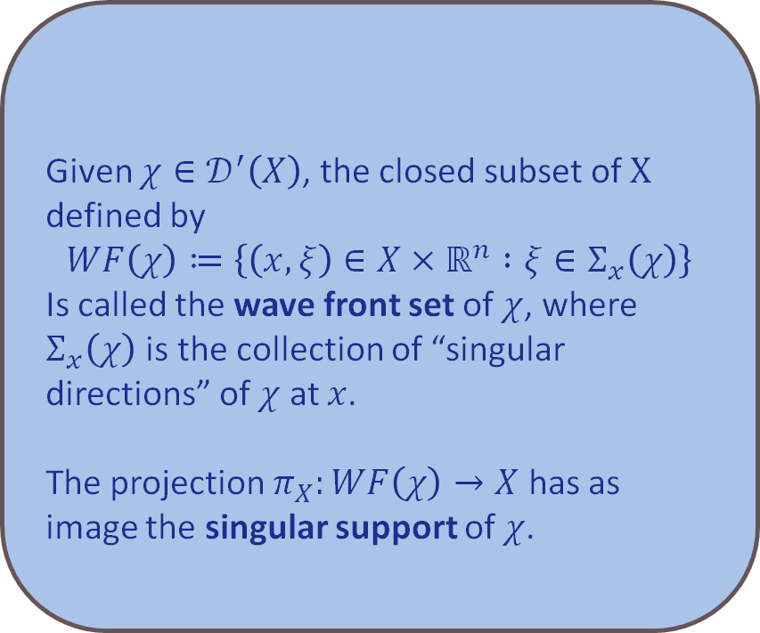
Singularities and Wavefronts
Given $χ∈𝒟^{′}\left(X\right)$, the closed subset of $X$ defined by
$$WF\left(χ\right)≔\left\{\left(x,ξ\right)∈X×ℝ^{n} :ξ∈Σ_{x}\left(χ\right)\right\}$$
Is called the wave front set of $χ$, where $Σ_{x}\left(χ\right)$ is the collection of “singular directions” of $χ$ at $x$.
The projection $π_{X}:WF\left(χ\right)→X$ has as image the singular support of $χ$.
Definition:
Notes:
Although distributions can be differentiated arbitrarily their singularities are still perceivable through a tool known as the wave front set, which is a key tool in microlocal analysis. The wavefront set of a distribution records the points where the distribution is locally singular, as well as the direction of singularity. Explicitly, locally near points outside a distributions singular support its action may be represented via integration with respect to a smooth function. I won’t go into detail into how this set of singular directions is defined, but the idea is that the fourier transform of a smooth function has propagation directions as inputs, and its smoothness is equivalent to a certain rapid decay feature in any given direction. It can be shown that a distribution acts like a smooth function if its Fourier transform has this decay feature as well.

Slide 18
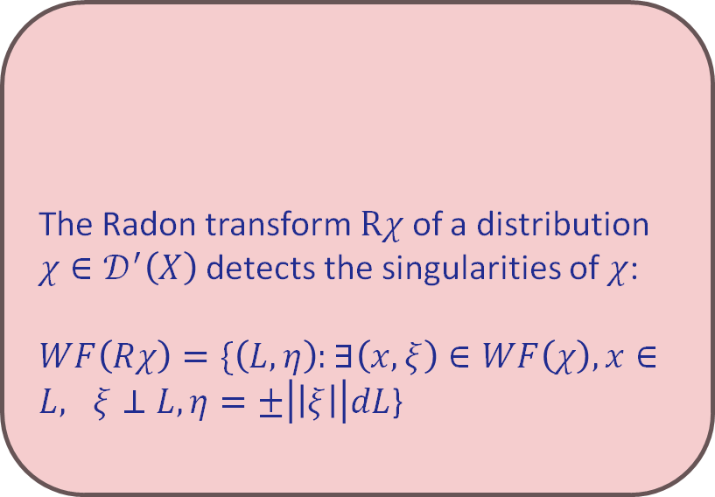

Singularity Detection In Radon Transform
The Radon transform $Rχ$ of a distribution $χ∈𝒟^{′}\left(X\right)$ detects the singularities of $χ$:
$WF\left(Rχ\right)=\{\left(L,η\right):∃\left(x,ξ\right)∈WF\left(χ\right),x∈L, ξ⊥L,η=±\left|\left|ξ\right|\right|dL$}
Remark:
$$P$$
Notes:
A key result in the study of inverse problems involving integral operators like the Radon transform is how they preserve the singularities of the original distribution. In the case of the 2D Radon transform, the singularities of the original distribution can be detected. In particular, if we consider a distribution with support something like the picture on the right, and we are investigating all of the possible values of the Radon transform for this distribution, the lines which are perpendicular to the direction of singularity at a point for the original distribution will detect this singularity. This can be extremely useful in limited data tomography applications. However, since in our case all of our lines are tangent to an interior circle, rather than the exterior boundary we are trying to recover, this approach is insufficient.

Slide 19
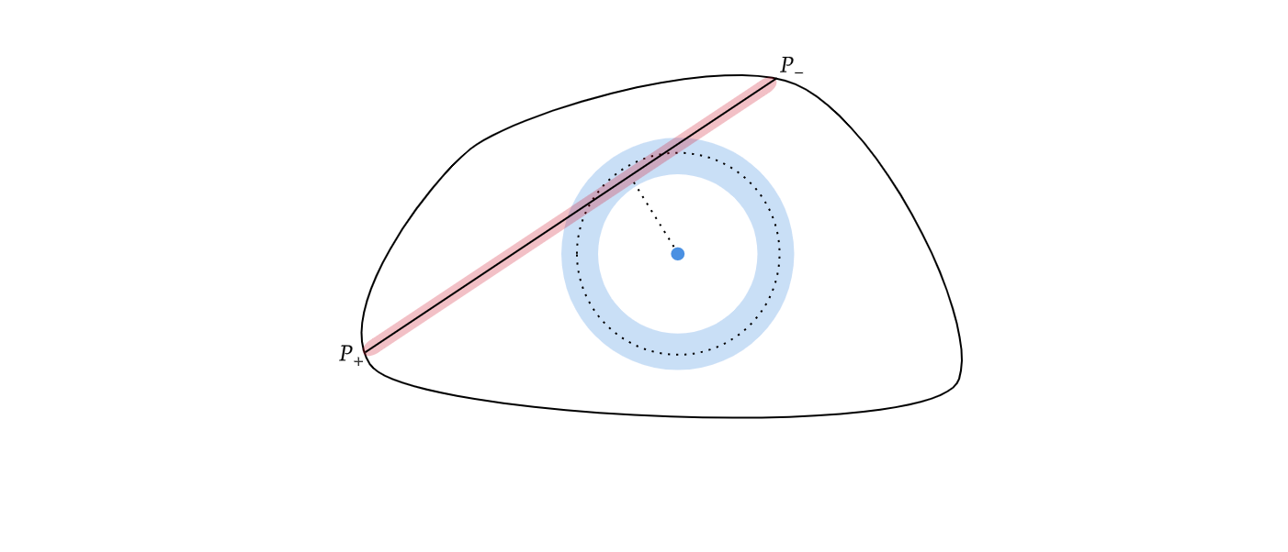
Infinitesimal Thickening
Boundaries and Lines
Methods of microlocal analysis can still be used to determine equations on limited data
$$∂_{θ}Rχ_{Ω}\left(1,θ\right)=\left\langle \left(xν_{y}−yν_{x}\right)δ_{∂Ω}δ_{L},1\right\rangle =\frac{\det{(P_{+} ν\left(P_{+}\right))}}{|\det\left(T\left(P_{+}\right) T_{θ}\right)|}+\frac{\det{(P_{−} ν\left(P_{−}\right))}}{|\det\left(T\left(P_{−}\right) T_{θ}\right)|}$$
Notes:
Nonetheless, certain microlocal methods can be still used for our limited data. In particular, since we know all radial tangents along the circle we’ll have the radial rate of change of the Radon transform as well. Then we can express our unknown data in terms of this known data through a process I like to refer to as infinitesimal thickening. Informally we approximate distributions corresponding to integration along the line and the boundary in order to leverage the local smoothness of the Radon transform about the unit circle. The key aspect that we use from microlocal analysis in this approach is that the product of distributions can only be defined when the distributions do not have common singularities.
However, as you can see this approach gives a deeply coupled equation due to the nature of our data.

Slide 20
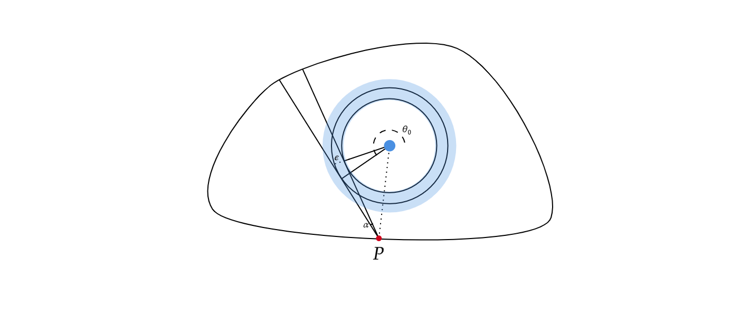
Infinitesimal Thickening
Boundaries and Lines
On the other hand, using the thickened data can provide sufficient conditions for uniqueness
Fig. Local parameterizations from thickened data.
Notes:
Nonetheless, a similar approach can be used to guarantee uniqueness for our infinitesimally thickened data set.

Slide 21
SUMMARY
What are inverse problems
The appearances of inverse problems in imaging and the Radon Transform
Example of a limited data inverse problem
Local techniques for studying inverse problems

Slide 22
THANK YOU for your time!
Any Questions?

